Slide 1
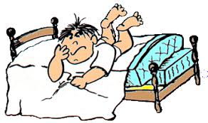
Managing Sleep Difficulties
Dr Laura Roughan, Consultant Clinical Psychologist

Slide 2
Zoom Group Rules
We ask you remain on Mute so background noise does not disturb the group.
Please keep everything discussed in the group that may disclose knowledge about an individual confidential.
You are welcome to have the video on or off (your choice).
Please use the CHAT function to communicate with the facilitators and we will do our best to address you question or share your comment before the end of the session.
If something has made you feel uncomfortable in the group, do tell us on the chat and we will address this as much as we can.

Slide 3
Session overview
Sleep – consequences, problems, assessment
ASD & Sleep
Strategies: Sleep Hygiene

Slide 4
How much sleep do young people need?
Research suggests school-aged children need between 8-12 hours sleep

Slide 5
Sleep problems
Avoiding going to bed
Anxiety about going to bed
Needing someone else present in order to go to sleep
Sleeping in parent bed/bedroom
Difficulty falling asleep
Waking and getting up in the night

Slide 6
Consequences of children not meeting their sleep need
In the morning
Hard to get out of bed
Hard to wake up (falling back to sleep)
Feeling tired/sleepy
Feeling irritable/grumpy
Lack of appetite for breakfast
Not focused on getting ready for school
Feeling unwell (headache/stomach ache)

Slide 7
Consequences of children not meeting their sleep need
At school
Difficulty concentrating
Difficulty remembering information
Feeling tired/sleepy/irritable
Deterioration in school work/performance
Increased difficulties with social interactions
Aggression
Yawning (constant)

Slide 8
Consequences of children not meeting their sleep need
After school
Feeling flat and unmotivated
Wanting to lie down/go to bed
Falling asleep/napping
Not willing to engage in activities

Slide 9
Sleep & Mental health
Poor mental health
(stress, anxiety, depression)
Poor sleep

Slide 10
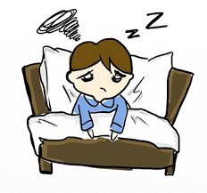
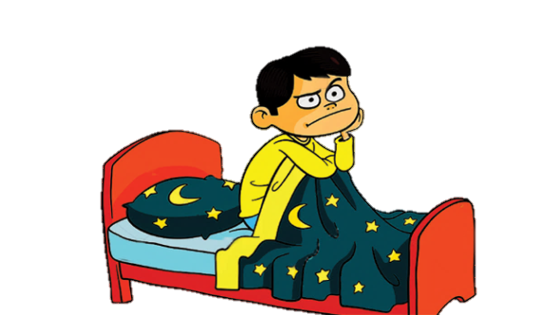
Autism and Sleep
Sleep difficulties
Having difficulty settling, winding down & going to sleep
Increased anxiety
Social cueing problems around bed times
Increased sensory sensitivities
Autism and the brain/
chemical differences

Slide 11
What is recommended for Treatment of Sleep problems?
The National Institute for Health and Care Excellence (NICE) recommends:
Assess any sleep problem to determine the problem and contributing factors.
Use a diary to record sleeping patterns and bedtimes
Develop a sleep plan in order to encourage the child or young person to develop positive sleep habits
Do not consider using medication until it is clear that behavioural interventions are not working
Always consult a specialist pediatrician or psychiatrist before using Medication. These should be reviewed on a regular basis to ensure that the benefits outweigh the side effects and risks
You should refer the child or young person to a sleep expert if you observe loud snoring, choking or apneas (the cessation of airflow during sleep caused by an obstruction).

Slide 12
Why can’t my child sleep?

Slide 13
Sleep Diaries
Identify areas of consistency
Identify areas of praise and positive reinforcement
Recognise triggers

Slide 14
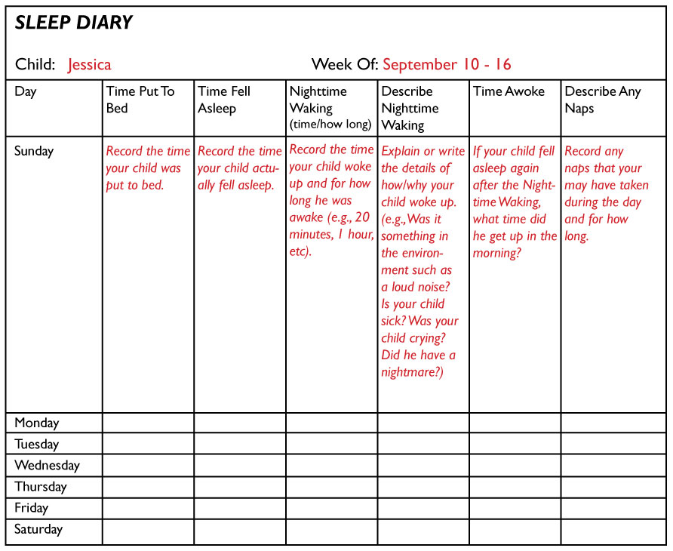
Sleep Diary

Slide 15
Treating Sleep Problems
Sleep Hygiene
Anxiety management/ Relaxation Strategies
Medication

Slide 16
Sleep Hygiene Strategies for Children with ASD

Slide 17
Sleep Hygiene
What is ‘sleep hygiene’?
- Different practices and habits that help you to have a good quality of sleep and alertness during the day

Slide 18
Sleep hygiene - During the day
Cut-out caffeine (coffee, tea, fizzy-drinks, chocolate, Red-Bull, energy drinks) from afternoon onwards.
Avoid large meals a few hours before bed.
Try aerobic exercise for 20 -30 min everyday between 4-6 pm.

Slide 19
Pre-bedtime Routine
Fix a time to go to bed and go to bed consistently at this time every night.
Have a set bedtime routine - create a 4 or 5 step sleep ritual (e.g. Warm bath, milk drink, putting nightwear on, brushing teeth, etc.) then follow the same routine every night.
Dim lights a couple of hours before going to bed.
Avoid over-stimulation before bed time
Cut out all electronic stimulation 1-2 hours pre-sleep

Slide 20
Lifestyle: Winding Down Time
Winding down is a critical stage in preparing for bed
There are lots of ways to relax
Warm bath (not too hot). Help your body reach a temperature that is ideal for rest
Writing a ‘to do list’ for the next day – this can help organise your thoughts and clear your mind of any distractions
Relaxation exercises: meditation, narrated script, relaxation music
Reading a book or listening to music / radio to relax the mind by distracting it
Notes:
What do you do to wind down?
This can be part of your routine, so that your body knows that you are preparing for bed e.g. have a warm shower/bath, then brush your teeth, then read a book

Slide 21
Visual Timetables
Consistent Routine is key to good Sleep
7:00pm 7:50pm
Bath time Clean teeth
7:30pm 7:55pm
Pyjamas Story
7:45pm 8:00pm
Drink/snack Tucked in
Example for a younger child

Slide 22
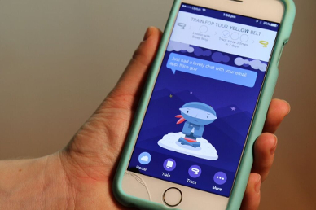
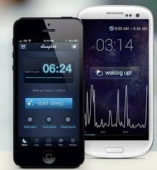
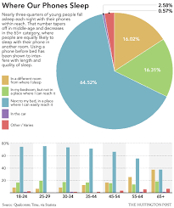
Visual Timetables- Sleep Apps
Young People may prefer to monitor their own sleep and see what impact doing sleep hygiene has on it.

Slide 23
Visual Timetables
Establishes a bedtime routine
Helps encourage relaxing behaviours to help the child wind down
Puts time restrictions on use of tablets/computers

Slide 24
In the bedroom
Keep room temperature slightly cooler at night.
Try essential oil of lavender - use a few drops on the pillow cover every few days.
Use the bed only to sleep or do pre-sleeping tasks (like reading a book or mindfulness recordings).
Read a book in bed if still can't sleep – but not an exciting one as that might keep you awake.
Background noise of rain, rustling leaves, sleep hypnosis or very low volume music may help some people.

Slide 25
Relaxation
Relaxation exercises, controlled breathing, mindfulness are all strategies that can help with sleep
Body Scan, Leaves on a Stream, relaxing music
Notes:
We will cover some relaxation exercises throughout these sessions, and we will explain in more detail what mindfulness is
Today we will try the body scan exercise. Has anyone heard of this/tried it before?

Slide 26
Relaxation Videos/Apps
Kids Sleep Dr App: developed by the Evelina
-Interactive sleep diary and sleep tips based on your child's age
-No blue light in app so does not affect sleep
Calm: a meditation and sleep app
- Contains sleep stories aimed at children
- Has guided imagery and progressive relaxation options
Headspace for Kids: meditation and mindfulness for children for a range of ages
- Includes bed time meditation
- Adult version too

Slide 27
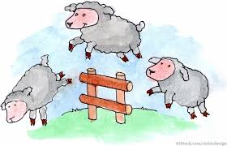
Could other things be contributing to poor sleep?
Worries e.g. about school
Separation anxiety e.g. not wanting to sleep in own bed
Fears e.g. scared of the dark
Sensory sensitivities e.g. not liking the feel of the duvet
Environment e.g. noisy or not dark enough
Physical health needs e.g. low iron, pain

Slide 28
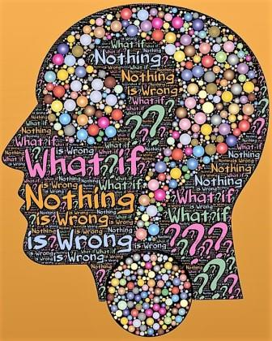
5. Worry and sleep
Worry can get in the way of sleep. Even worry about not sleeping.
“If I don’t sleep I won’t be able to focus tomorrow!”
We can still function on reduced sleep – it’s not harmful.
Worrying about getting to sleep
Struggle to get to sleep
Clock watch
Notes:
Scientists have found a direct correlation between anxiety and rhythm of sleep. When a person is anxious, their heart rate increases, which causes the brain to ‘race’, too. An alert mind produces beta waves, making you far too stimulated to sleep. To make matters worse, an active brain triggers other worries, so it’s even harder to achieve sleep.
Once this pattern sets in, bedtime can become a thing of anxiety. So how can you combat the stress of sleeping?

Slide 29
You might want to make a Sleep Plan at home and think about changes you can make to help your child/young person with ASD and their sleeping difficulties.

Slide 30
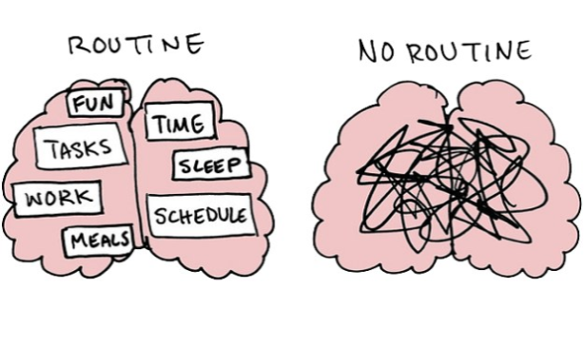
Key to success
Persistence
Consistency
Your child’s sleep pattern will not change over night
It will take a minimum of 4-6weeks to get into a new routine
Discuss with your child the changes you are looking to make – have them involved
Some children might resist changes at first – maintain boundaries and persist with the interventions

